Slide 1
Brandwise Mobile Sales Dashboard
AUTHOR
REVATHY

Slide 2
Problem Statement
Businesses selling mobile phones often struggle to: - Track brand-wise performance - Identify top-selling models - Analyze regional sales trends - Understand customer purchase behavior. This project solves these problems by building an interactive Power BI dashboard using a dataset of 5000 records.

Slide 3
Objective
Analyze mobile sales performance by brand
Identify top 10 selling models
Track monthly and yearly sales trends
Provide actionable insights for business decisions

Slide 4
Dataset Information
Total Rows: 5000
Columns
Order ID
Date
Brand
Model
Region
Quantity Sold
Price
Total Sales
Customer Type
Payment Mode

Slide 5
ETL Process (Power Query Editor - PQE)
1. Extract
Imported dataset (Excel/CSV) into Power BI
2. Transform (Data Cleaning)Performed using Power Query Editor:
Removed duplicates
Handled missing values
Changed data types
Split columns where required
Created calculated columns (Total Sales = Quantity \* Price)
Standardized text values (Brand names, Regions)
3. Load
Loaded cleaned dataset into Power BI model

Slide 6
Data Modeling
Created relationships between tables (if applicable)
Built measures using DAX:
Total Sales
Total Quantity
Average Price
Top 10 Models

Slide 7
Dashboard Features
KPI Cards (Total Sales, Quantity, Revenue)-
Brand-wise Sales Bar Chart-
Monthly Sales Trend Line Chart-
Region-wise Sales Map-
Top 10 Models Table-
Interactive Filters (Brand, Region, Date)

Slide 8
Importance of the Project
Helps businesses make data-
Driven decisions-
Improves sales strategy planning-
Identifies high-performing brands and regions-
Enhances reporting efficiency

Slide 9
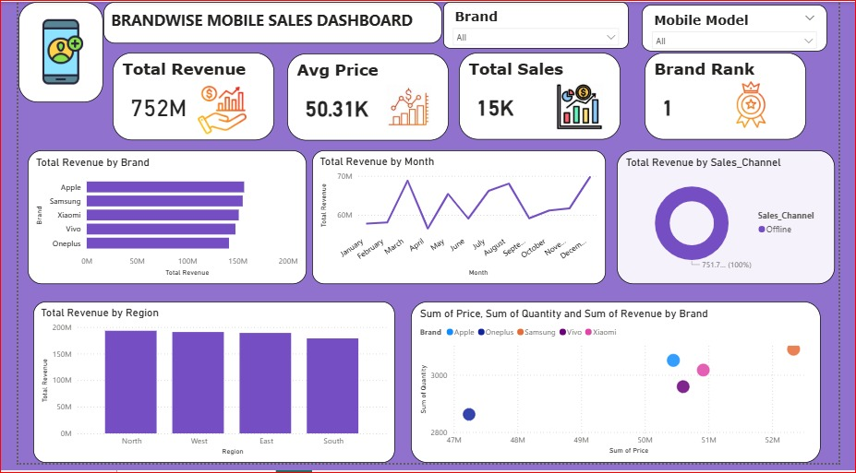
Dashboard Preview

Slide 10
Tools Used
Microsoft Power BI
Power Query Editor (ETL)
DAX (Data Analysis Expressions)
Excel / CSV Dataset

Slide 11
Conclusion
This dashboard provides a complete overview of mobile sales performance and enables stakeholders to make informed decisions quickly.

